Slide 1
A Blockchain-Based Secure De-centralized Storage System
Team Details
G.SHIVA SAI BALAJI(21EG505826)
K.RAHUL(21EG505835)
K.SREE NAILU(21EG505842)
Project Supervisor
Dr. P. Ravinder Rao
Assistant professor

Slide 2
Introduction
What it is:
It describes a blockchain-based security sharing scheme for personal data named BSSPD (Blockchain-Based Security Sharing Scheme for Personal Data). It addresses the challenge of maintaining data ownership, security, and privacy in the context of data sharing within the AI-driven era. BSSPD integrates blockchain technology, ciphertext-policy attribute-based encryption (CP-ABE), and the Inter-Planetary File System (IPFS) to create a decentralized and user-centric approach to data sharing and access control.
What is needed:
Blockchain Technology
Ciphertext-Policy Attribute-Based Encryption (CP-ABE)
Inter-Planetary File System (IPFS)
What are applications:
Personal Data Sharing
Healthcare Data Management
Education purpose
Research Collaboration

Slide 3
Problem Statement
Problem Statement:
In the current data-sharing landscape, where privacy protection and open sharing are paramount, traditional approaches rely heavily on centralized cloud servers, leading to concerns regarding data ownership, security, and privacy. Despite advancements in encryption and access control technologies, these solutions still depend on the credibility of third-party Cloud Service Providers (CSPs), leaving users vulnerable to potential privacy breaches and data misuse. There is a critical need for a decentralized and user-centric data-sharing management platform that empowers individuals to retain ownership and control over their data while ensuring security and privacy.

Slide 4
Proposed Method
In this we use Block Store Protocol. BlockStore makes use of a special structure called Space Wallet SW. The space wallet keeps track of storage space available to renters in BlockStore. A consensus algorithm helps in maintaining a consistent blockchain across the peers. We show that Block Store can be built using known cryptographic primitives like proofs of retrievability, proofs of space, signature schemes, and resource allocation algorithms.
The parameters improved in this project are:
Storage Efficiency
Consistency
Security
User privacy

Slide 5
Proposed Method
Illustration :
The proposed method introduces a revolutionary Blockchain-Based Secure Decentralized Storage System. Utilizing smart contracts, it ensures transparent and secure data transactions. A peer-to-peer network of nodes distributes data, enhancing redundancy and fault tolerance. End-to-end encryption guarantees user privacy and data security. A token economy incentivizes node participation, creating a self-sustaining ecosystem. Through a secure consensus mechanism, the system validates and records transactions on an immutable blockchain, ensuring tamper resistance.

Slide 6
Experiment Environment
RAM: 8 GB (minimum)
Hard Disk: 20 GB
Operating System: Windows 8Professional
Programming Language: python

Slide 7
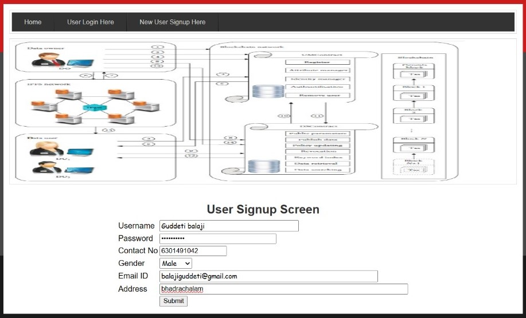
Experiment Screen shorts

Slide 8
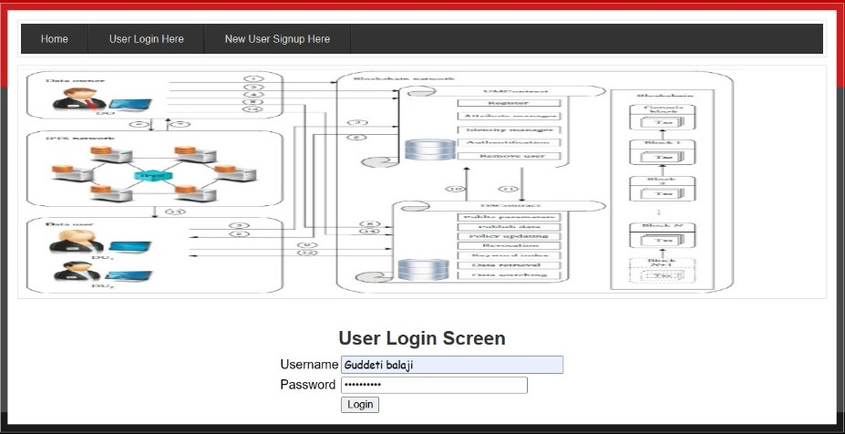
Experiment Results

Slide 9
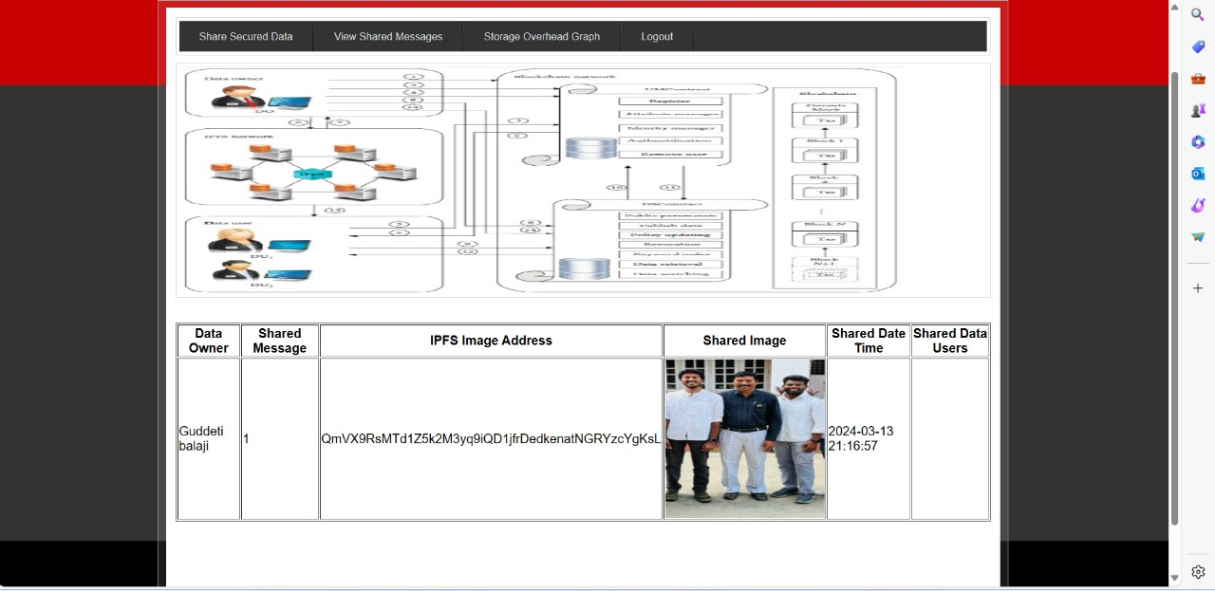
Experiment Results

Slide 10
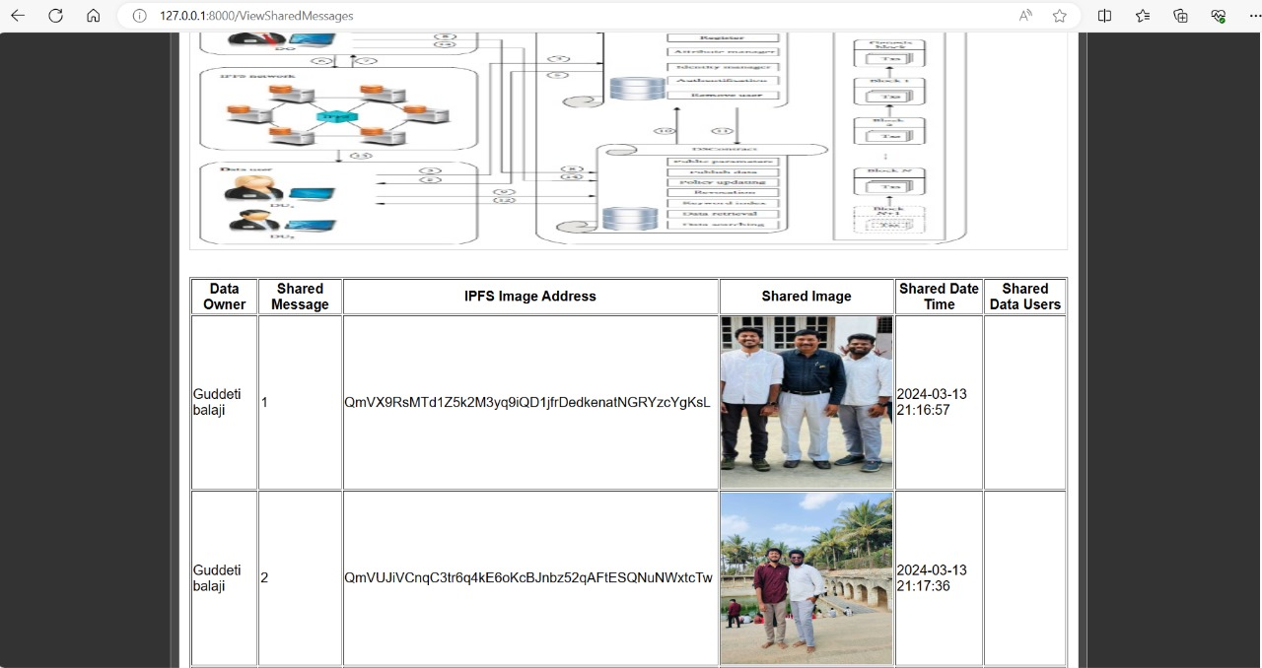
Experiment Results

Slide 11
Finding
The findings reveal that a blockchain-based decentralized storage system offers a solution to the prevalent challenges in data sharing. By eliminating centralized servers, users gain control over their data, enhancing ownership and privacy.
Blockchain's cryptographic techniques ensure security through encryption and immutable record-keeping, mitigating risks associated with unauthorized access and data breaches.
Moreover, the removal of intermediaries reduces dependency on third-party entities, minimizing the likelihood of data misuse.

Slide 12
Justification
1.What are parameters improved by your method?
Parameters improved by implementing blockchain includes reliability, speed, trust, transparency and security. This method eliminates the middlemen, reduces paper work and ensures integrity and accessibility in the process.
2.Why your parameter values improved?
These parameter values are improved because blockchain eliminates the need for intermediaries, streamlines the verification process and enhances the accessibility. By leveraging cryptographic methods and consensus algorithms, blockchain ensures trust, transparency, and security and more efficient.

